Slide 2
Read the words
to sing songs
Reading
to play sports
story
Man and the World
Maths
to count
test
PE
teacher
to draw
Belarusian
to solve problems
school
to make things
English
my
Technology
subject
IT

Slide 3
The theme of the lesson
My School

Slide 4
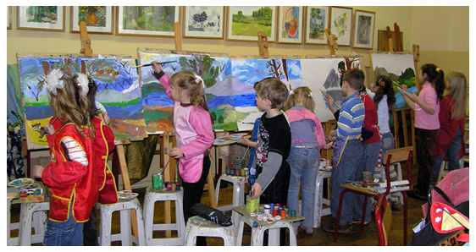
B
A
C

Slide 5
Present Continuous Tense
to be + V-ing
(am, is, are)

Slide 21
Do you like the lesson?
Present Continuous is easy
Present Continuous is difficult
The lesson was boring
The lesson was interesting

